Slide 1
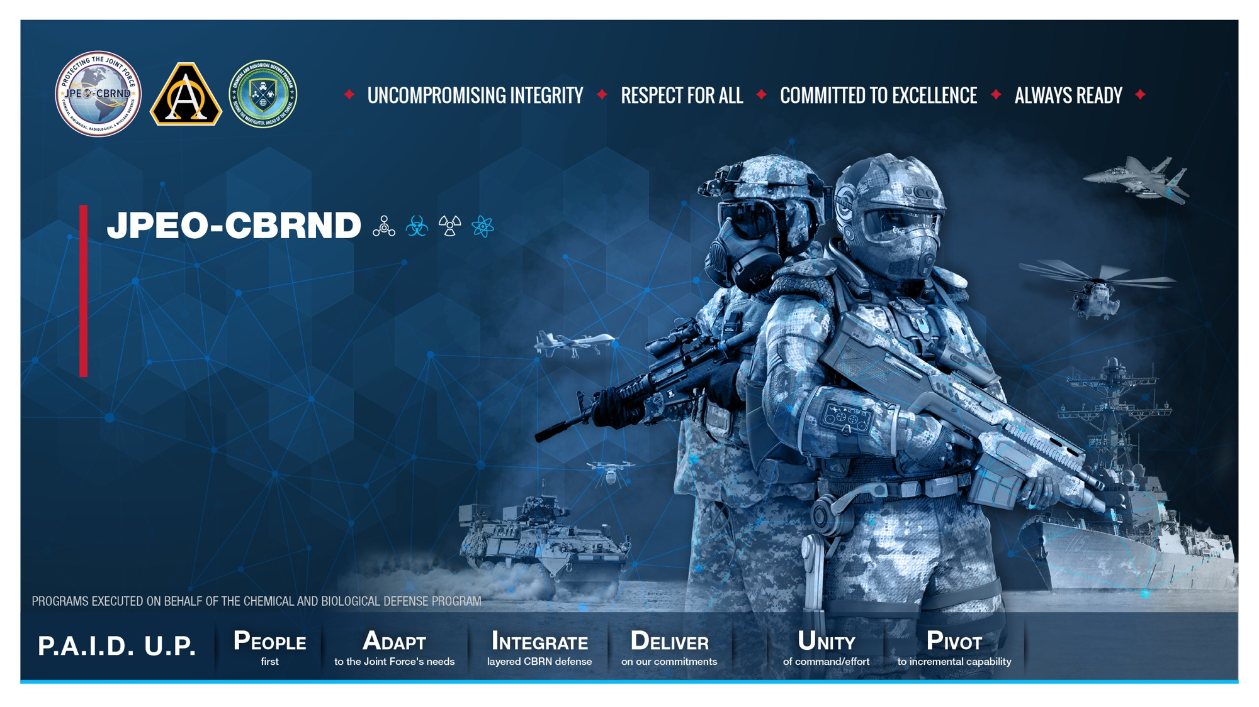
Command Brief
UNCLASSIFIED
Date
Presenter Name
Presenter Title
DISTRIBUTION STATEMENT A. Approved for public release. Distribution unlimited.
UNCLASSIFIED
Notes:
Introduction
Good morning/afternoon, I’m [Name], [Position] at the Joint Program Executive Office for Chemical, Biological, Radiological and Nuclear Defense.
I’d like to start by thanking [Organizer Name] for the opportunity to speak with you today about our mission, portfolio, and strategy.

Slide 2

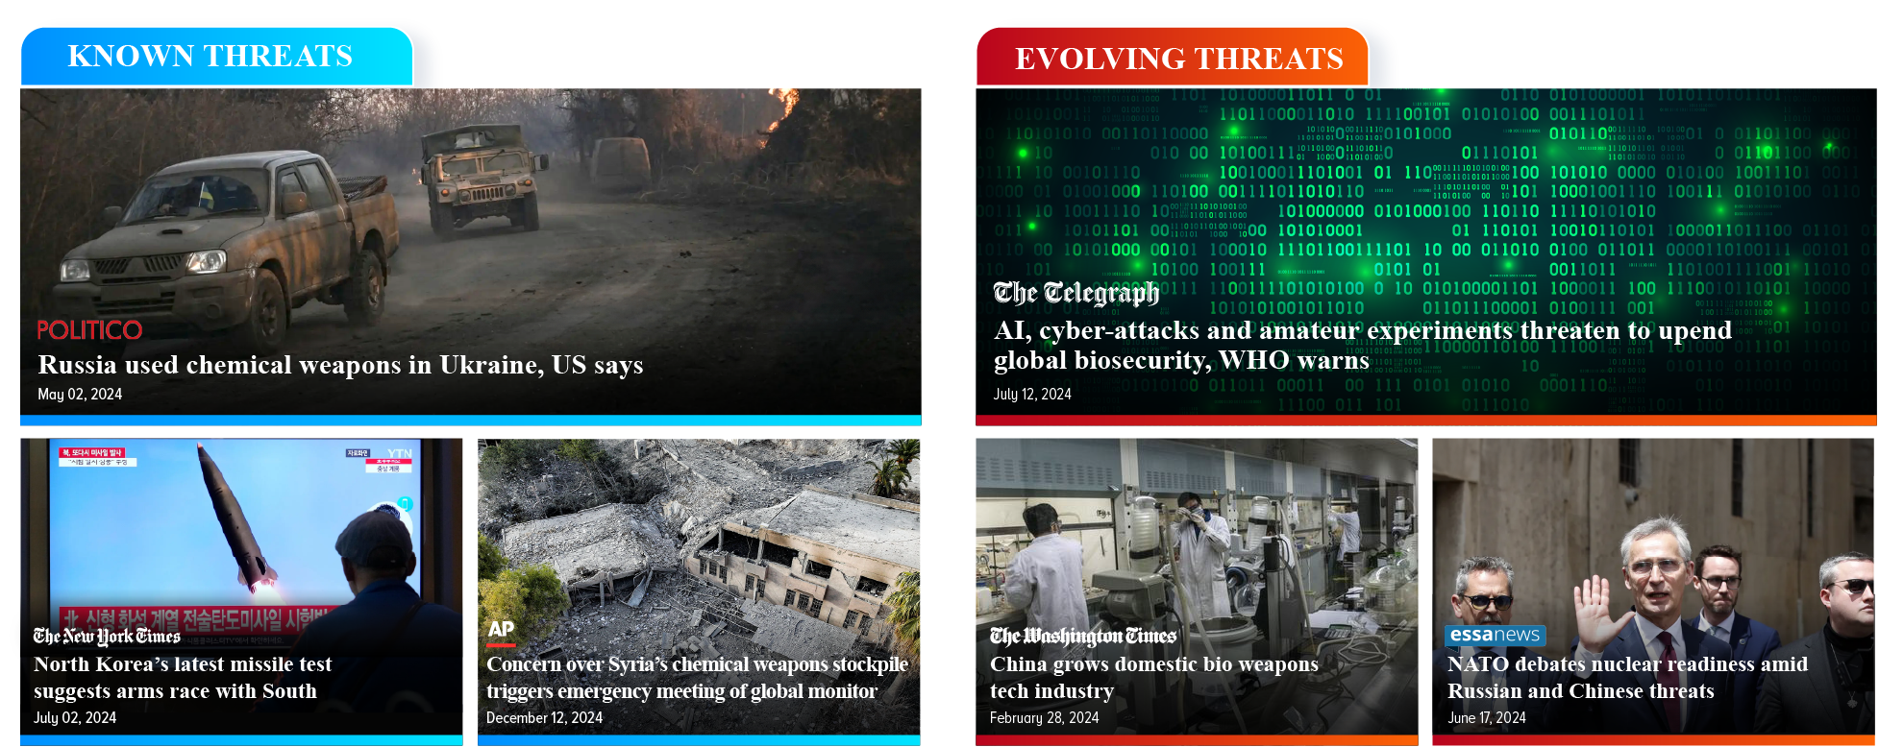
We Face A Complex Threat Environment
UNCLASSIFIED
Notes:
Complex Threat Environment
Today’s threat environment continues to be complex and evolving, requiring us to always strive to be one step ahead.
As you can see from the headlines, we must prepare for and respond to the full spectrum of chemical, biological threats.
To combat today’s complex threat environment, we provide layered CBRN defense capabilities to the warfighter to enable them to quickly understand any CBRN threat so they can effectively protect themselves and their equipment against it and mitigate any impacts the threat may have.
When those three groupings of capabilities are successfully layered on top of each other, our warfighters are able to fight and win in a denied CBRN environment.

Slide 3
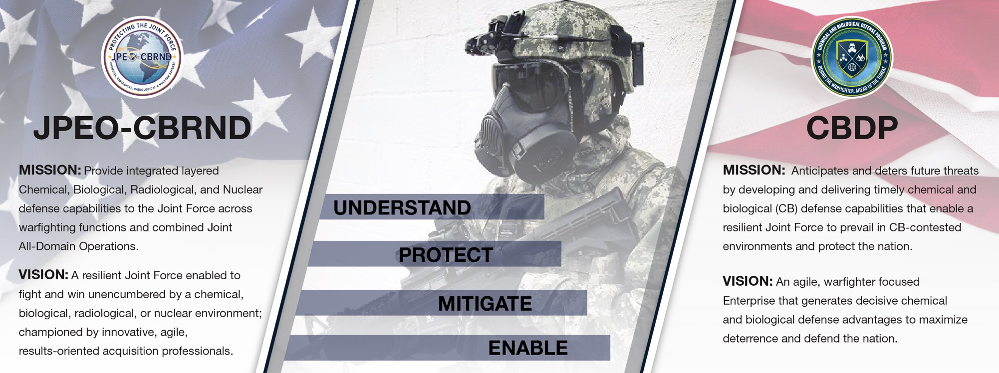
Who we are and what we do
UNCLASSIFIED
Notes:
Who We Are and What We Do
Before we get into what we are doing to combat the threat, let me tell you a little about who we are and what we do.
On the left side, you see the JPEO-CBRND’s mission and vision, and on the right side you see the mission and vision of the DOD’s Chemical and Biological Defense Program, or CBDP. I’ll talk more about this on the next slide but, in short, the CBDP provides guidance and direction on which capabilities we develop.
Our missions go hand-in-hand with each other, with overarching focus areas centered around supporting integrated deterrence to deny our adversaries any advantage, or perceived advantage, to using CBRN weapons.
Integration has become very important to the JPEO because developing connections—whether they’re between organizations, allies, or equipment—gets us one step closer to establishing a shared, common understanding of the CBRN battlespace to support all levels of Command decision-making.
You’ll hear me mention integration multiple times throughout this command brief.
Our mission at the JPEO-CBRND is to:
Provide integrated layered CBRN defense capabilities to the Joint Force across warfighting functions and combined Joint All-Domain Operations.
Our vision has two parts:
The first part is to have a Joint Force that can fight and win even in the face of CBRN threats.
The second part is to have a skilled workforce that’s dedicated to keeping our warfighters safe from CBRN threats.

Slide 4
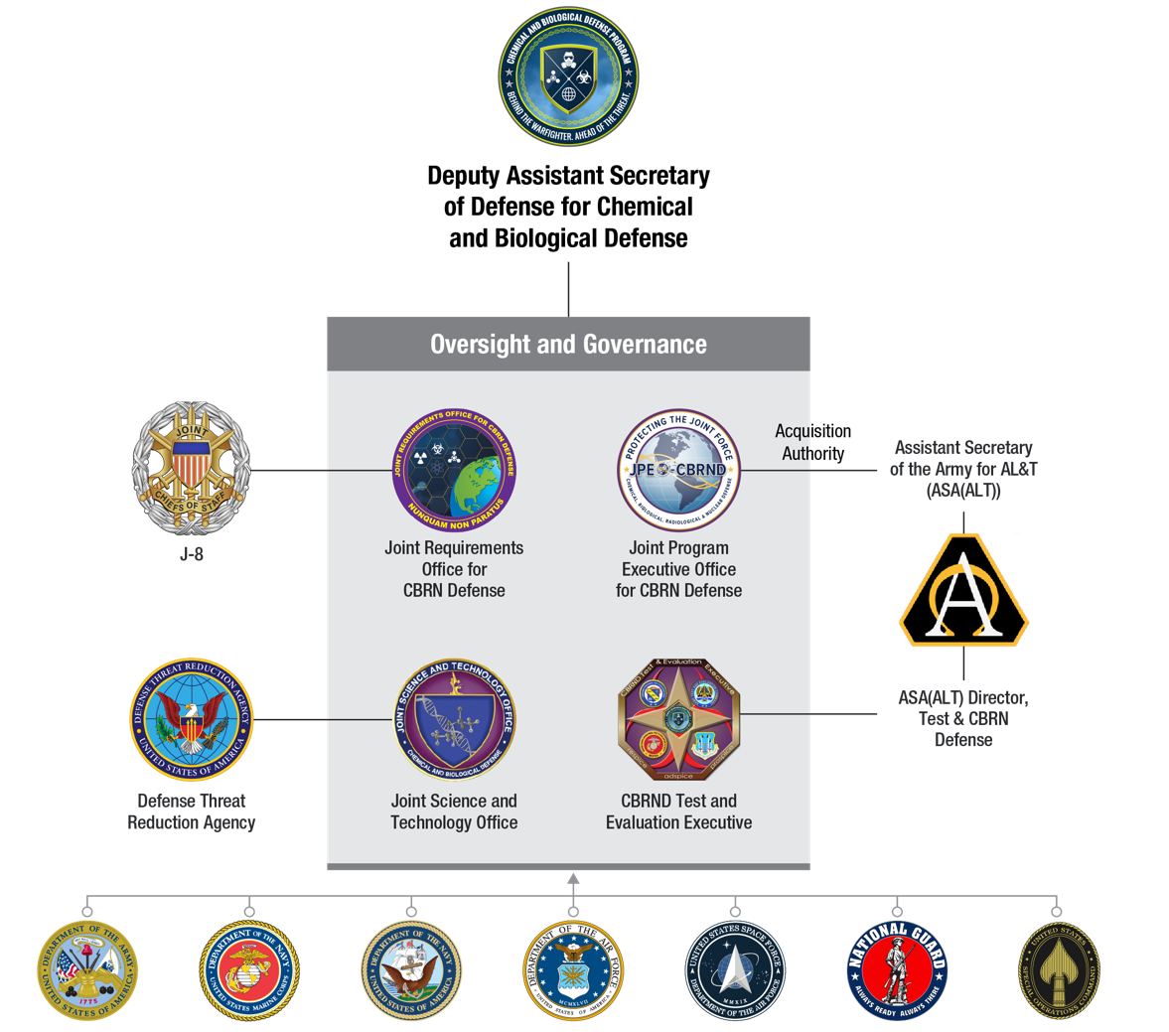
National Policies and Guidance
UNCLASSIFIED
National Security Strategy (2022)
Interim National Defense Strategic Guidance (2025)
DoD Strategy for Countering Weapons of Mass Destruction (2023)
Biodefense Posture Review (2023)
Army Biological Defense Strategy (2021)
Chemical and Biological Defense Program Enterprise Strategy (2024)
…and others in development and coming soon
Notes:
National Polices and Guidance
Our goals are informed by National and Defense Department strategies, which are outlined on the left here.
Some of those strategies are the National Security Strategy, the National Defense Strategy, and the Chemical and Biological Defense Program Enterprise Strategy.
We map our goals to the DoD and Army chains of command to ensure our Defense acquisition resourcing and authorities​ are unified.
Inside the gray box on the right are the four organizations that make up the Chem-Bio Defense Program.
The Deputy Assistant Secretary of Defense for Chemical and Biological Defense, often referred to as the DASD, oversees this program.
As I mentioned, our guidance to develop capabilities comes from the CBDP, but each of our four organizations also has our own “administrative” higher headquarters. For us at the JPEO, we are part of the Army Chain of Command.
The Assistant Secretary of the Army for Acquisition, Logistics, and Technology, or ASA(ALT), provides our acquisition authority as shown here on the right.
The Service logos at the bottom of this slide represent the foundation of Chem-Bio Defense Program. We exist to serve the needs and requirements of our supported combatant commands, Soldiers, Sailors, Airmen, Marines, and Guardians.

Slide 5






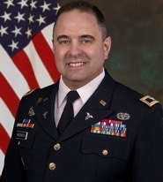

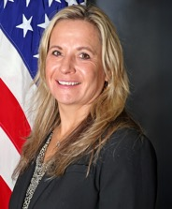


JPEO-CBRND
ORGANIZATION Leadership
UNCLASSIFIED
JPEO
Mr. Darryl Colvin
Executive Assistant
Ms. Quneitra Quintero
Deputy JPEO
Ms. Nicole Kilgore
Executive Assistant
Ms. Carol Keyes
Chief of Staff
Mr. Gordon Graham
Director for Acquisition
& Systems Management
Mr. Wyatt Ulrich
Joint Warfighter
Concept Integrator
Ms. Rachel Overman
Joint Project Managers (JPM)
Joint Project Leads (JPL)
JPM CBRN Protection
Mr. Steven Batts
JPM CBRN Medical
COL John Nuckols​
JPM CBRN Sensors
Mr. Timothy Tharp
Acting JPM CBRN Special Operations Forces
Ms. Deborah Olson
JPL CBRN Integration
Mr. Paul Gietka
JPL CBRND
Enabling Biotechnologies
Mr. Bruce Goodwin
Deputy JPM
Ms. Stacey Shepherd
***************
Executive Assistant
Ms. Brenda Lopez-Price
Deputy JPM
Mr. Jeff Zerhusen
***************
Executive Assistant
Ms. Holly Randles
Deputy JPM
Mr. L. Clay Williamson
***************
Executive Assistant
Ms. Nicole Harris
Deputy JPM
TBA
***************
Executive Assistant
Ms. Michelle Stier
Deputy JPL
LTC Denyada Barnes
***************
Executive Assistant
Ms. Jeanette Benton
Deputy JPL
Ms. Nicky Dorsey
***************
Executive Assistant
Ms. Nehemirah Maxwell
Notes:
JPEO Leadership
Now, let’s take a look at the leaders that drive the strategy and goals for the JPEO.
Mr. Darryl Colvin is our JPEO, and Ms. Nicole Kilgore is our Deputy JPEO.
We have four Joint Project Managers that develop equipment for the warfighter, each with a different focus area. They are CBRN Protection, CBRN Medical, CBRN Sensors, and CBRN Special Operations Forces.
We also have two Joint Project Leads that coordinate across the JPMs and Chem-Bio Defense Community. They are CBRN Integration and CBRND Enabling Biotechnologies.

Slide 6
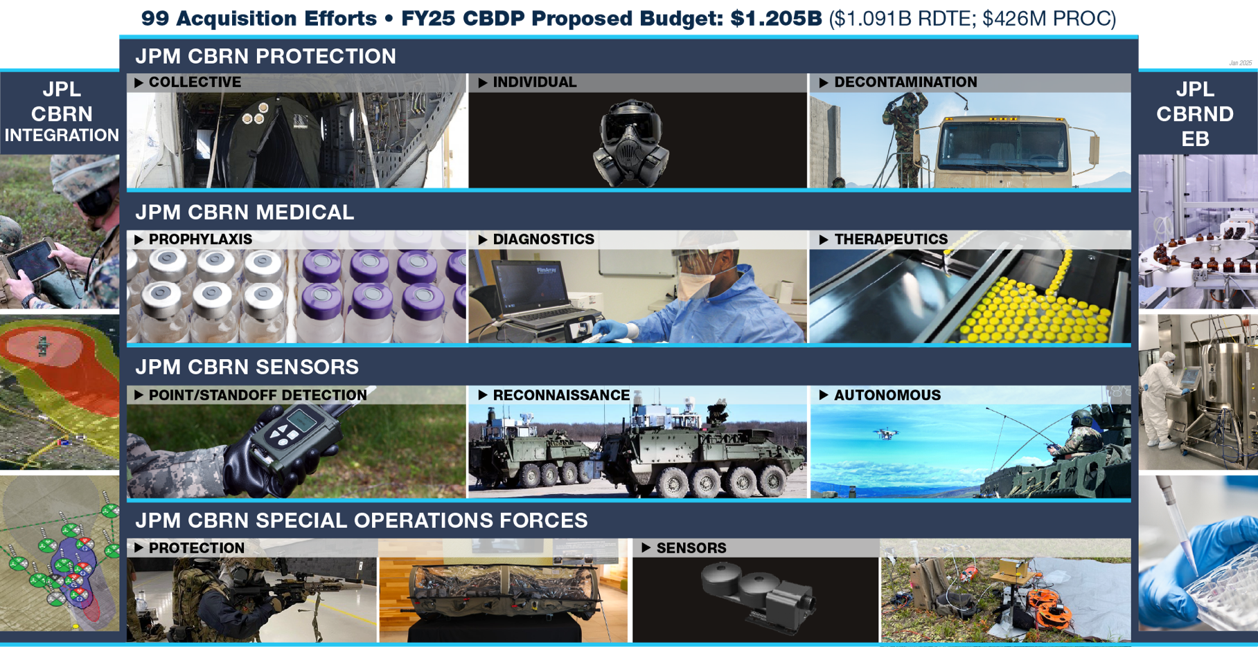
JPEO-CBRND Portfolio Overview
JA2
Notes:
JPEO-CBRND Portfolio
As you see here, our four Joint Project Managers – Protection, Medical, Sensors, and Special Operations Forces – are represented horizontally.
The JPMs manage traditional Programs of Record to develop Protection, Sensors, Medical, and Special Operations capabilities.
Our Protection portfolio develops and fields collective protection equipment (such as tents and isolation units), individual protection equipment (such as masks and suits), and decontamination capabilities that are used to clean equipment after it’s been exposed to a threat.
Our Medical portfolio develops and fields vaccines and other preventive treatments, diagnostic equipment, and post-exposure treatments.
Our Sensors portfolio develops and fields capabilities that detect CBRN threats and determine how much contamination occurred after a CBRN incident.
And our SOF team works to bring protection and sensors equipment to Special Operations Forces.
The Joint Project Leads—Enabling Biotechnologies and Integration—work across the JPMs to provide crosscutting technologies and capabilities that help the JPMs deliver incremental improvements to the warfighter.
And you’ll see they both span all the JPMs, which is very deliberate placement. The JPLs support programs and efforts across all the JPMs.
So, for the most part, they’re not executing traditional Programs of Record like the JPMs are. The JPLs work almost “behind the scenes” on efforts and initiatives that improve capabilities or even lay the groundwork for other capabilities.
Earlier, as part of our mission, I mentioned our focus on integration. This slide shows how the different types of capabilities within the JPEO all work together as one JPEO team.

Slide 7
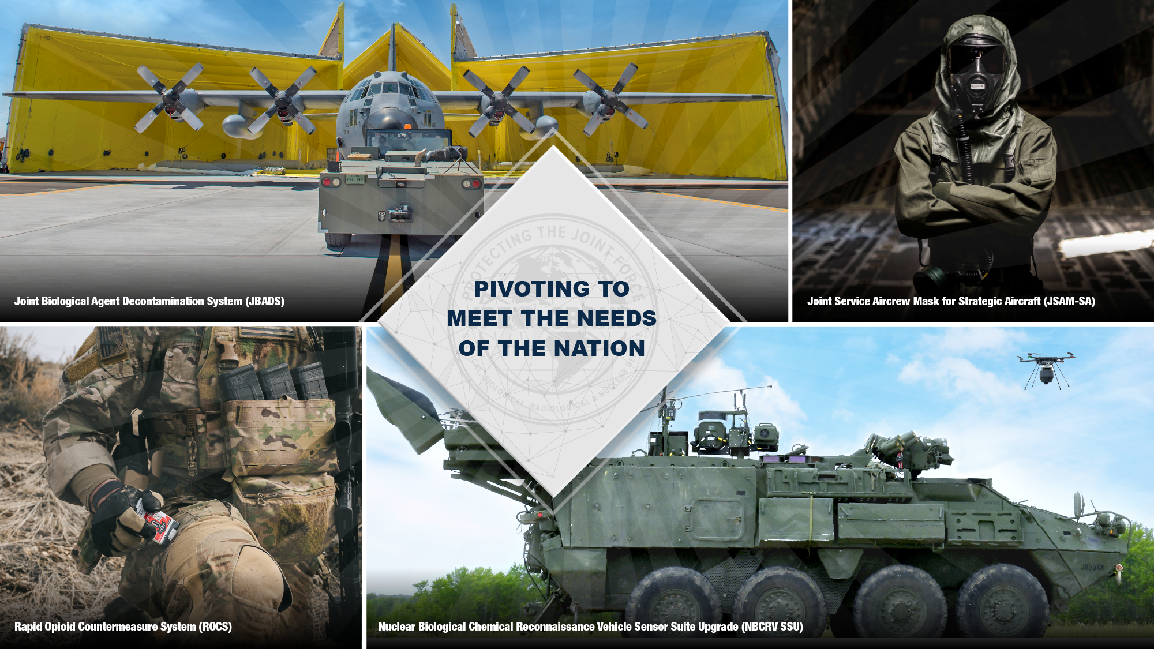
Notes:
Pivoting to Meet the Needs of the Nation
For our mission to be successful, we need to take an integrated approach.
We must identify and develop enterprise services that can achieve integration of all CBRN capabilities and data with existing user systems across the services to achieve Joint All Domain Command and Control.
And interoperability of CBRN data and non-CBRN data to create a holistic picture of that includes CBRN information.

Slide 8

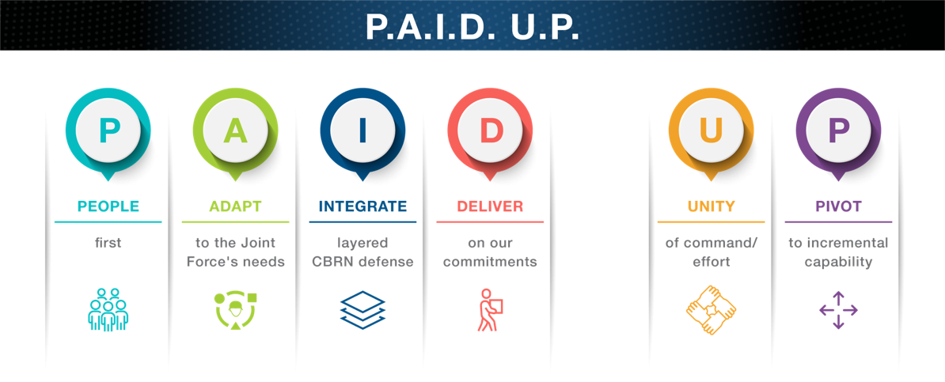
JPEO-CBRND P.A.I.D. U.P. Approach to Advance Our Mission
UNCLASSIFIED
Notes:
P.A.I.D. U.P. FY24 Pillars
As the advanced development arm of the CBDP, we are driven by the requirements from the Joint Force.
Our FY24 pillars are defined with the acronym P.A.I.D. U.P.
Not only is this an applicable, memorable acronym for us as an acquisition organization, but this is our approach to what and how we will achieve our mission of providing CBRN defense capabilities to the Joint Force across combined, Joint All-Domain Operations.
Using the P.A.I.D. U.P. approach, every program we manage and capability we field will align with one—or several—of these pillars:
People first always.
Adapt to the Joint Force’s needs,
Integrate layered CBRN defense,
Deliver on our commitments,
Unity of command and effort, and
Pivot to incremental capability,
As a JPEO with nearly 100 programs, it is critical that we are aligned in our efforts and focusing on the people that serve our mission every day.

Slide 9
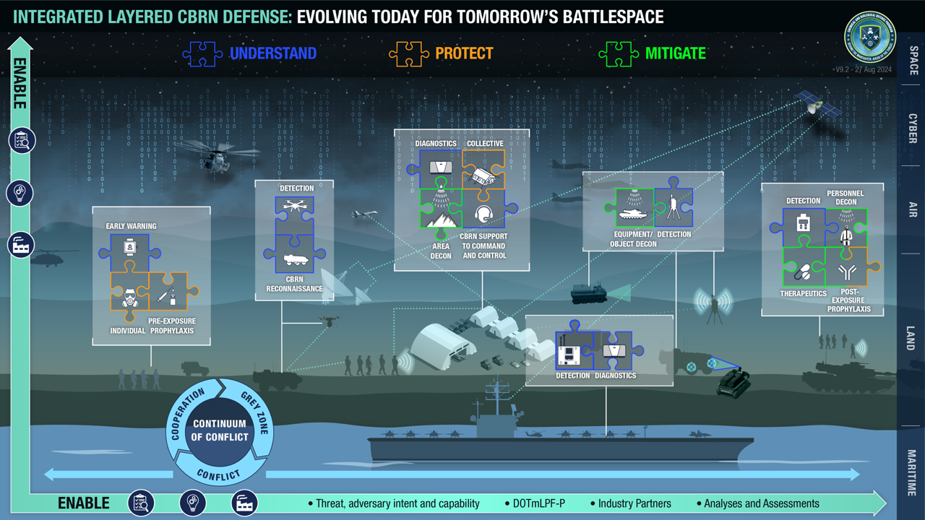


UNCLASSIFIED
Notes:
Integrated Layered CBRN Defense
Integrated Layered CBRN Defense is a multi-solution approach that gives the Joint Force layers of protection, from vaccines and medical treatments to protective equipment and situational awareness.
One layer might be a pre-exposure medical treatment, one might be PPE, and another might be early warning of hazards.
All layers must work together to provide total defense to our Warfighters, and each layer is critical.
Removing a layer could chip away at our defense, making our troops vulnerable to exposure and, potentially, unable to meet their mission.
A layered defense approach is especially important today when our understanding of the battlefield and threat is constantly evolving.
This OV-1 level view brings together the CBRN defense capabilities that work together to create the Integrated Layered CBRN Defense approach.

Slide 10
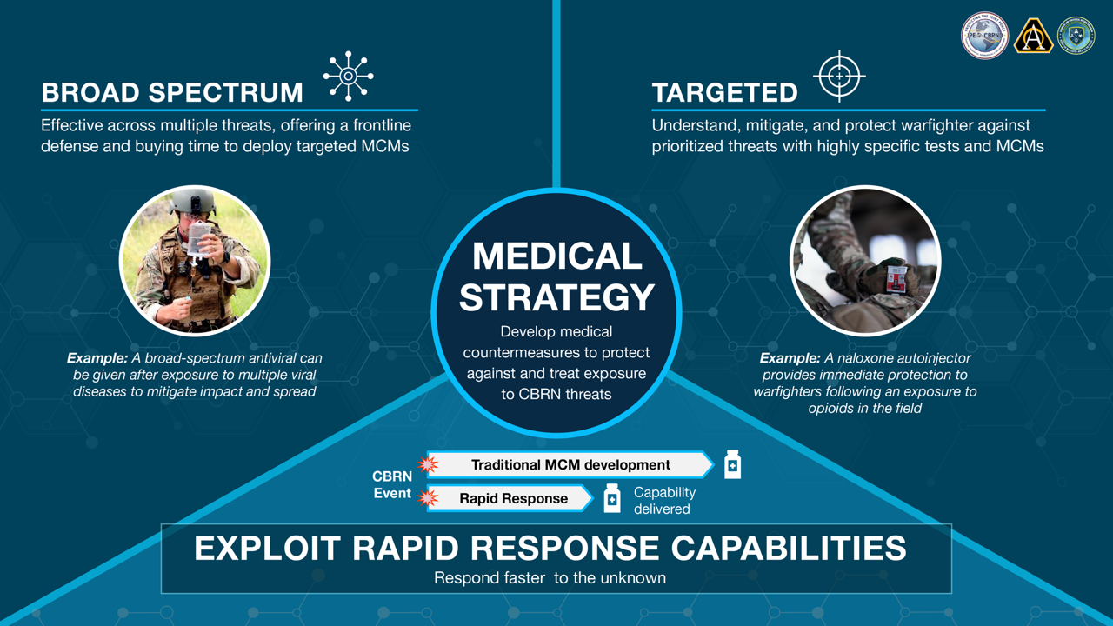
UNCLASSIFIED
UNCLASSIFIED
Notes:
Medical Strategy
Our Medical Strategy was developed to create a knowledge base against all the families of viral diseases to protect and treat the Joint Force.
This strategy includes both broad spectrum and targeted medical countermeasures:
A broad-spectrum medical countermeasure is effective across multiple threats, offering a frontline defense and buying time to deploy targeted medical countermeasures.
A targeted medical countermeasure approach aims to understand, mitigate, and protect our warfighters against prioritized threats with highly specific tests and medical countermeasures.
This strategy includes programs and capabilities managed by our JPM CBRN Medical team and JPL CBRN defense enabling biotechnologies team.
At its core, our Medical Strategy aims to exploit rapid response capabilities to respond faster to the unknown while keeping our Joint Forces at the forefront.

Slide 11
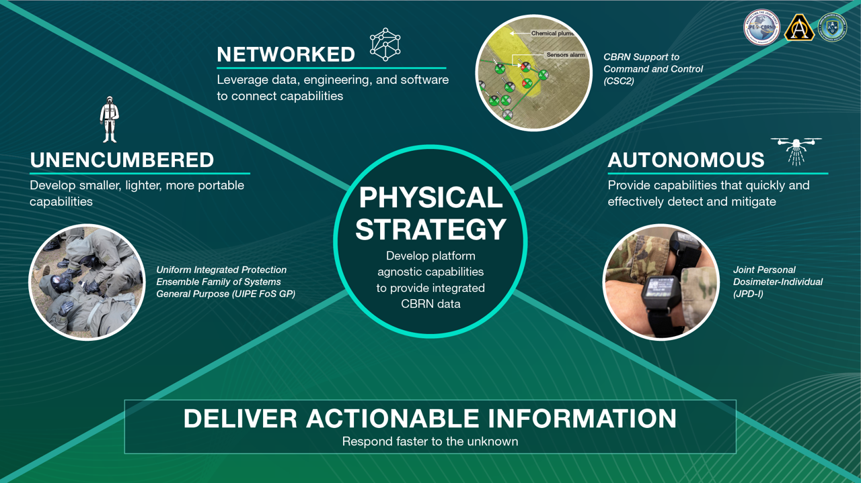
UNCLASSIFIED
UNCLASSIFIED
Notes:
Physical Strategy
Our Physical Strategy encompasses all the physical capabilities that serve our warfighters—from suits, boots, and sensors to specialized decontamination equipment.
The strategy spans multiple JPM and JPL teams, including JPM CBRN Protection, JPM CBRN Sensors, JPM CBRN Special Operations Forces, and JPL CBRN Integration.
This strategy looks outward at delivering innovative capabilities that are:
Unencumbered, maximizing the warfighter’s tactical flexibility and fighting strength by fielding capabilities that are smaller, lighter, and more portable,
Networked to other CBRN and non-CBRN capabilities to provide timely, more complete situational understanding, and
Autonomous to provide capabilities that quickly and effectively detect and mitigate CBRN threats while minimizing the logistical burden and cost of conducting CBRN defense operations.
At its core, our Physical Strategy aims to develop platform agnostic capabilities to provide integrated CBRN data to deliver actionable information to command decision makers faster.

Slide 12
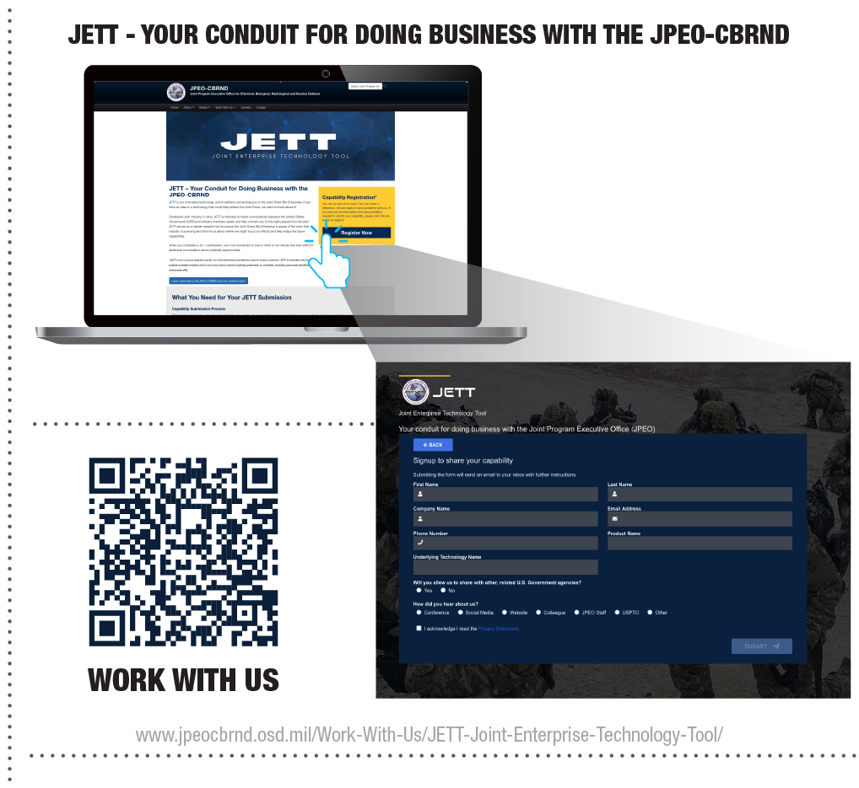
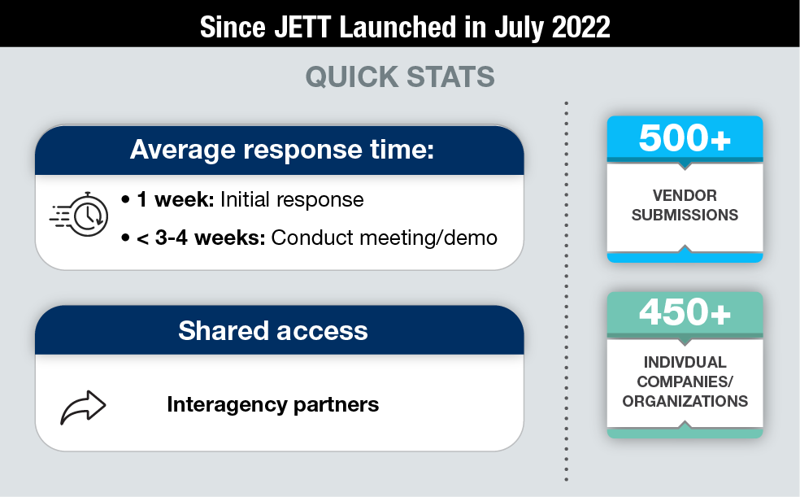
Joint Enterprise Technology Tool (JETT)
UNCLASSIFIED
Connect Directly with the JPEO-CBRND
Web-based industry engagement tool
Connects companies to appropriate points of contact based on answers to a short questionnaire
Cross-enterprise access facilitates collaboration among and with government organizations
Notes:
JETT
The Joint Enterprise Technology Tool, or JETT, is a web-based engagement tool designed for industry, academia, and laboratories to introduce their ideas and capabilities to the JPEO-CBRND so we can accurately and efficiently connect them with the “right” decision makers within the enterprise.
Developed with industry in mind, JETT is intended to initiate and sustain engagement between JPEO-CBRND personnel or partnered S&T organization contacts and industry members. JETT serves to connect potential business partners to the right office or organization to facilitate meaningful discussion.
If you have an idea or a technology that could help us protect the Joint Force, we’d like to engage with you to learn more.
JETT is a great way to connect the latest innovations in industry with the complex challenges that our JPMs and JPLs or partnered organizations are working to solve.
JETT also serves as a market research tool for increased awareness of the work that industry is currently or historically pursuing and informs key personnel as to where the JPEO-CBRND and CBDP enterprise can shape future pathways.
JETT also provides support through event registration management for events hosted by CBDP enterprise organizations. JETT provides public access for vendors to browse and register for upcoming events relevant to their focus areas. JETT also functions as a space to collect responses and relevant capability submissions to externally posted RFIs.
To clarify, JETT is not a guarantee of contract, work, funding, etc. However, JETT serves as a platform that connects vendors to government staff to discuss capabilities and offerings for future opportunities and it is much more effective than requesting office calls!
Scan the QR code on this slide to be directed to the Work With Us Page of the JPEO website where you can find additional information about JETT, guidance and what to expect when submitting a capability, and additional resources. When you’re ready, click the “Register Now” button shown here to begin your submission JETT!

Slide 13


SERVING THE
JOINT FORCE
UNCLASSIFIED
Notes:
Serving the Joint Force
The JPEO-CBRND team is a valued partner across the CBRN defense enterprise and as part of the whole-of-government response to the defense of our homeland.
We work closely together with the Services, Joint Requirements Office, Joint Science and Technology Office, and the DASD to develop, integrate, test, and deliver CBRN Defense capabilities to the Joint Force and our Allies and International Partners.
This slide summarizes the exciting milestones, fieldings, test events, and demos that we’ve accomplished lately and serves as a snapshot of the work we do every day in support of the Warfighter.

Slide 14


Contact
@JPEOCBRND
Mr. Darryl J. Colvin
Joint Program Executive Officer for
Chemical, Biological, Radiological and Nuclear Defense
410-436-4141
darryl.j.colvin.civ@army.mil
www.jpeocbrnd.osd.mil
Notes:
Conclusion
Thank you for your time today.
I’m happy to take any questions.

Slide 15
Backups
Notes:
JPEO-CBRND Team – The backups provided below feature other slides you can add to the main briefing or swap in place of a current slide. Prior to finalizing your briefing, please delete any backups that you do not intend to use.

Slide 16


















JPEO-CBRND organization
Mr. Darryl Colvin
Joint Program
Executive Officer
Ms. Nicole Kilgore
Deputy JPEO
Mr. Gordon Graham
Chief of Staff
Mr. Wyatt Ulrich
Director, Acquisition & Systems Management
Ms. Rachel Overman
Joint Warfighter
Concept Integrator
Joint Project Managers
Joint Project Leads
Assistant JPEOs and Special Staff
Mr. Steven Batts
JPM CBRN Protection
Mr. Timothy Tharp
JPM CBRN
Sensors
Mr. Paul Gietka
JPL CBRN Integration
Mr. Chris Kazmierczak
Asst. JPEO Strategic Engagements
Mr. Alfred Wong
Chief Data Officer
Vacant
Asst. JPEO Logistics
Ms. Ann Allen
Chief of Operations
COL John Nuckols​
JPM CBRN
Medical
Ms. Deborah Olson
Acting JPM CBRN
SOF
Mr. Bruce Goodwin
JPL CBRND Enabling Biotechnologies
Ms. Jen Dabisch
Asst. JPEO Medical Regulatory
& Acquisition Strategy
Mr. Josh Israel
Chief Engineer
Mr. George Sfakianoudis
Asst. JPEO
Business Management
Mr. Chris Newton
Chief People Officer
Notes:
JPEO-CBRND Organization
Now, let’s take a look at the leaders that drive the strategy and goals for the JPEO.
Mr. Darryl Colvin is our JPEO, and Ms. Nicole Kilgore is the Deputy JPEO.
We have four Joint Project Managers that develop equipment for the warfighter, each with a different focus area. They are CBRN Protection, CBRN Medical, CBRN Sensors, and CBRN Special Operations Forces.
We also have two Joint Project Leads that coordinate across the JPMs and Chem-Bio Defense Community. They are CBRN Integration and CBRND Enabling Biotechnologies.
Supporting our JPMs and JPLs, our HQ team is led by five Assistant JPEOs, the Chief of Operations, Chief Engineer, and Chief People Officer.

Slide 17
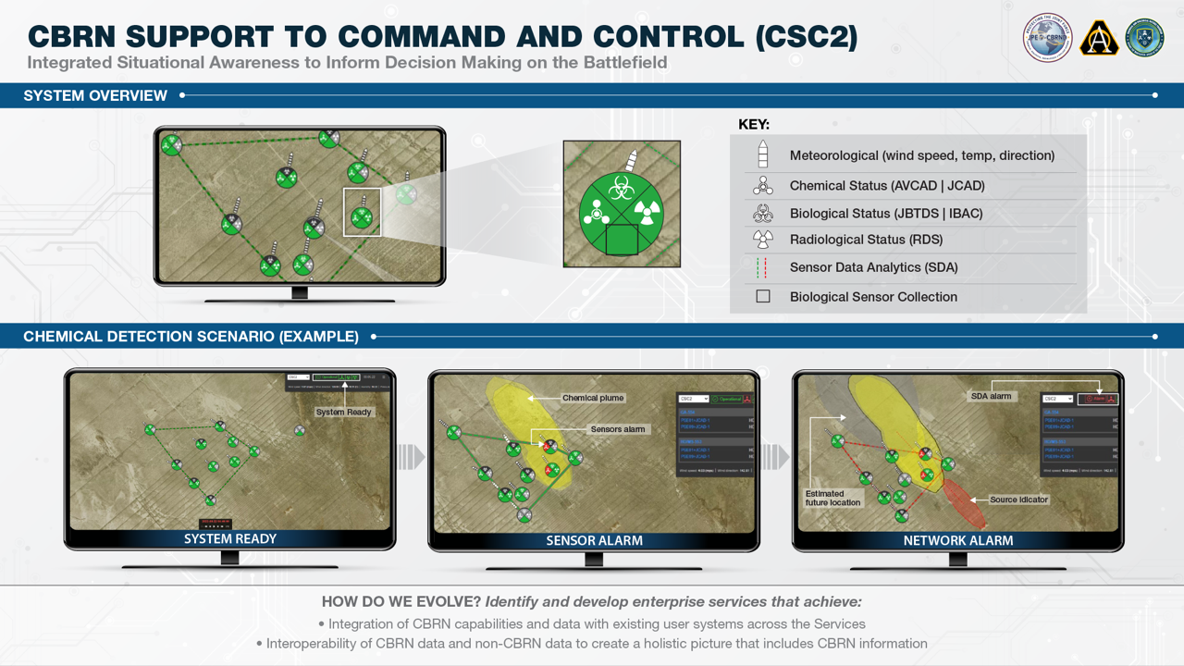
Notes:
CSC2 Integration Strategy
Our Integration Strategy is simple. We want the Warfighter to have as much information as possible at their fingertips so they can understand the environment and situation, make proactive decisions, and move faster toward mitigation.
And that requires systems and capabilities communicating with each other and working together to provide that situational understanding, getting actionable information the Joint Force faster.
Developing networked sensors that can communicate and share information with each other will be critical to achieve:
Integration of CBRN capabilities and data with existing user systems across the Services
Interoperability of CBRN data and non-CBRN data to create a holistic picture that includes CBRN information
We cannot think of CBRN environments as separate, isolated battlespaces because, in reality, they won’t be.
We have to ensure that CBRN defense capabilities are seamlessly integrated into all battlespaces using technology such as CBRN Support to Command and Control, or CSC2.

Slide 18
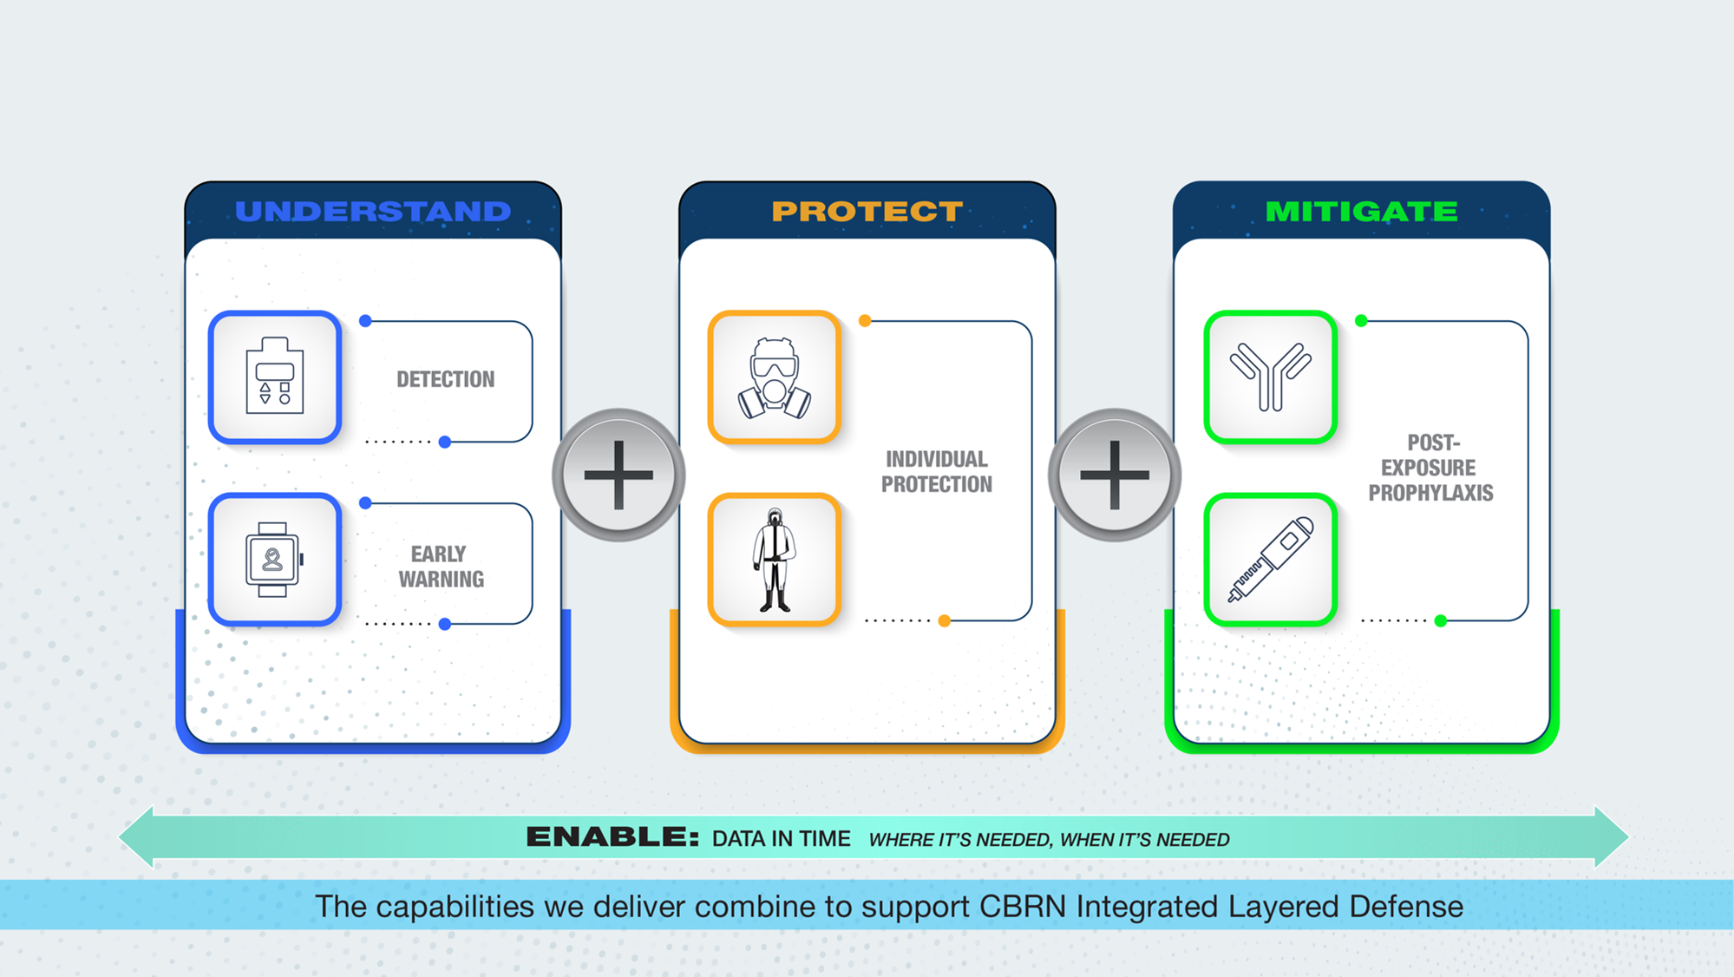

Capability Portfolio Management
Example for Supporting Structure of CBRN Integrated Layered Defense
UNCLASSIFIED
Notes:
Capability Portfolio Management
CBRN threats require that we provide integrated, layered deterrence capabilities to our ready, resilient forces.​
Capability Portfolio Management (CPM) is a critical element of Integrated Layered Defense, ensuring we focus our energy on the entire system of capabilities in combinations of our Joint Capability Areas (Understand – Protect – Mitigate – and Enable). ​
This approach helps us buy down risks and make risk-informed decisions by reviewing capability sets versus individual Programs of Record. ​

Slide 19
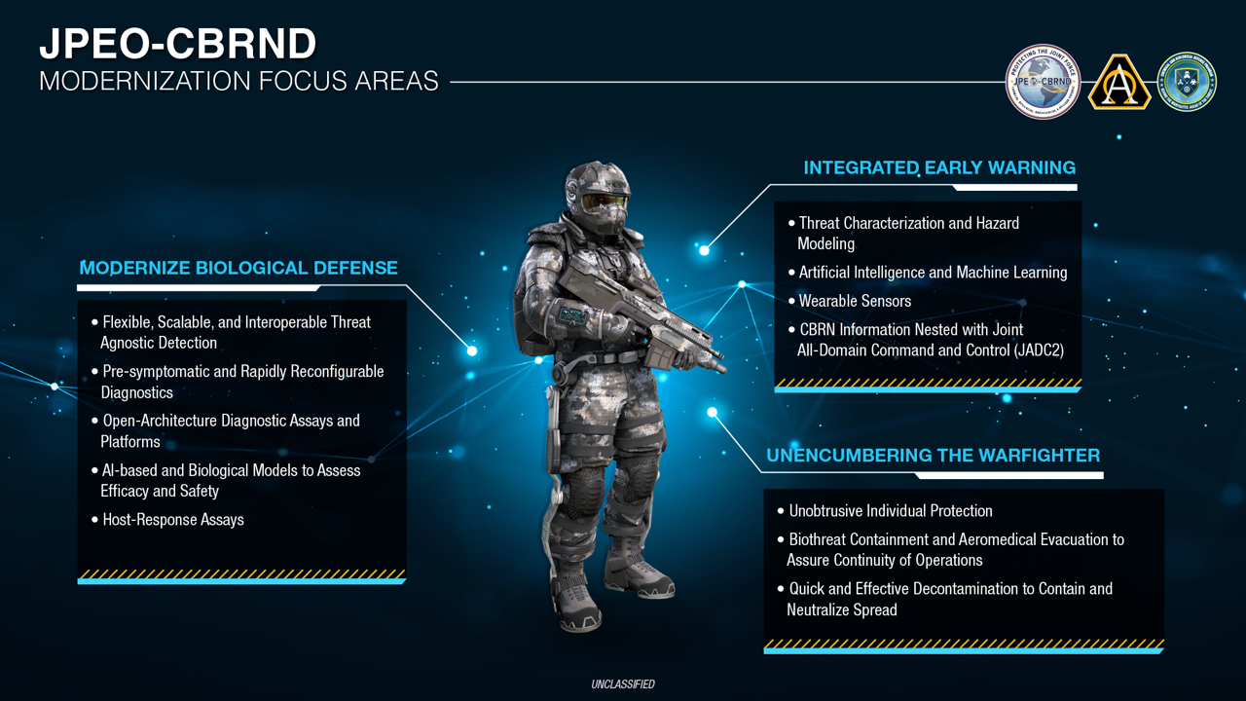
UNCLASSIFIED
Notes:
Modernization Focus Areas
To keep pace with the evolving threat environment, JPEO, in alignment with the CBDP, is focusing on three modernization areas:
Modernizing Biological Defense,
Advance and Integrated Early Warning,
and Unencumbering the Warfighter.
These priorities aim to tackle not just the conventional threats we’re familiar with, but also ensures we’re addressing new threats as they develop.
First, Modernizing Biological Defense remains one of JPEO’s top focus areas.
We must be able to quickly characterize a threat in order to develop and produce treatments and vaccines whenever the warfighter faces a new threat.
We need diagnostics that can be used in the field.
We’re also looking at ways to improve chemical diagnostic capabilities.
Next, Integrated Early Warning is what our integration efforts are aimed at addressing.
We’re looking at ways to better integrate sensor data across equipment, leverage Artificial Intelligence and Machine Learning,
And we’re looking to combine CBRN threat information with more traditional threat information like force protection sensors (such as radar and infrared), to allow Commanders to make informed decisions faster.
And Unencumbering our Warfighters. I think there’s a good chance that last one will always be on this slide—because, no matter what, we’ll always be working as hard as we can to keep Warfighter burden to a minimum.
We’re working on developing protective suits that weigh less and are not as hot as what we currently have.
We’re trying to find better ways to protect vision and breathing from CBRN threats, so that Warfighters don’t have to wear the uncomfortable, rubber mask.
We’re working on ways to decontaminate equipment without using water or other bulky equipment.
The success of these modernization priorities depends on many factors:
Our incredible workforce at the JPEO and across the Chem-Bio defense community,
Support from leadership at every level,
Integration and collaboration,
And learning from the past to respond more proactively, rapidly, and efficiently in the future.

Slide 20
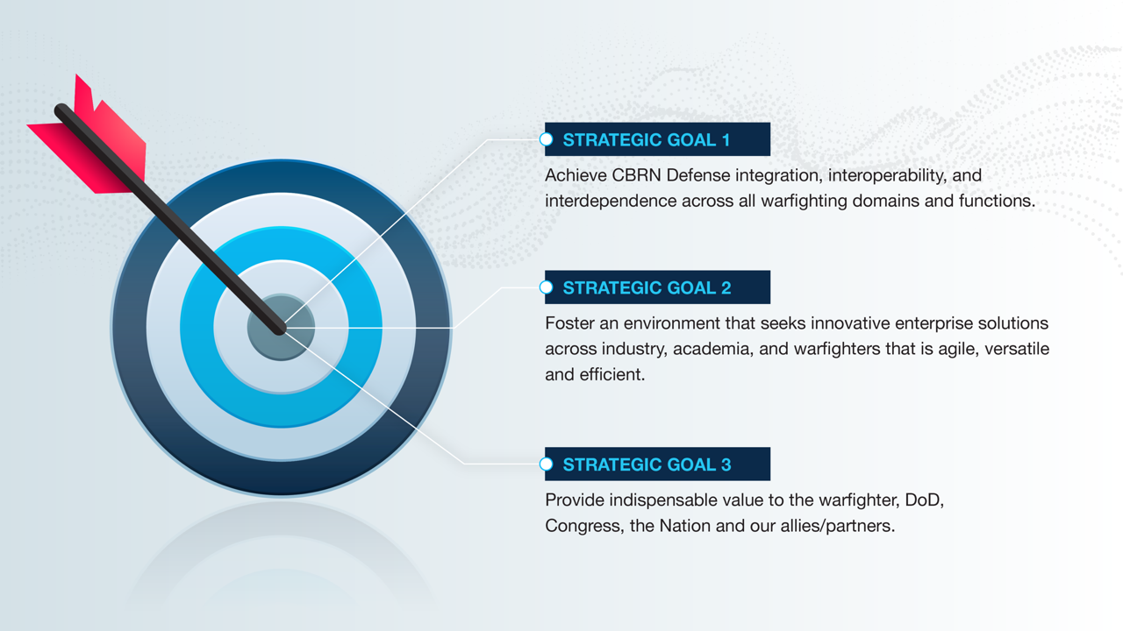

JPEO-CBRND STRATEGIC GOALS
UNCLASSIFIED
Notes:
JPEO-CBRND Strategic Goals
JPEO-CBRND launched our Strategic Campaign Plan in April 2023 to serve as an enduring but flexible plan that communicates what we do and why it is important.
The Plan’s Strategic Goals, Objectives, and Lines of Effort shape how the JPEO will support the Nation, our Joint Forces, Allies, and International Partners.
Our strategic goals are focused on three all-encompassing areas:
Achieve CBRN Defense integration, interoperability, and interdependence across all warfighting domains and functions
Foster an environment that seeks innovative enterprise solutions across industry, academia, and end users that is agile, versatile, and efficient
And provide indispensable value to the warfighter, DoD, Congress, the Nation, and our allies/partners.

Slide 21
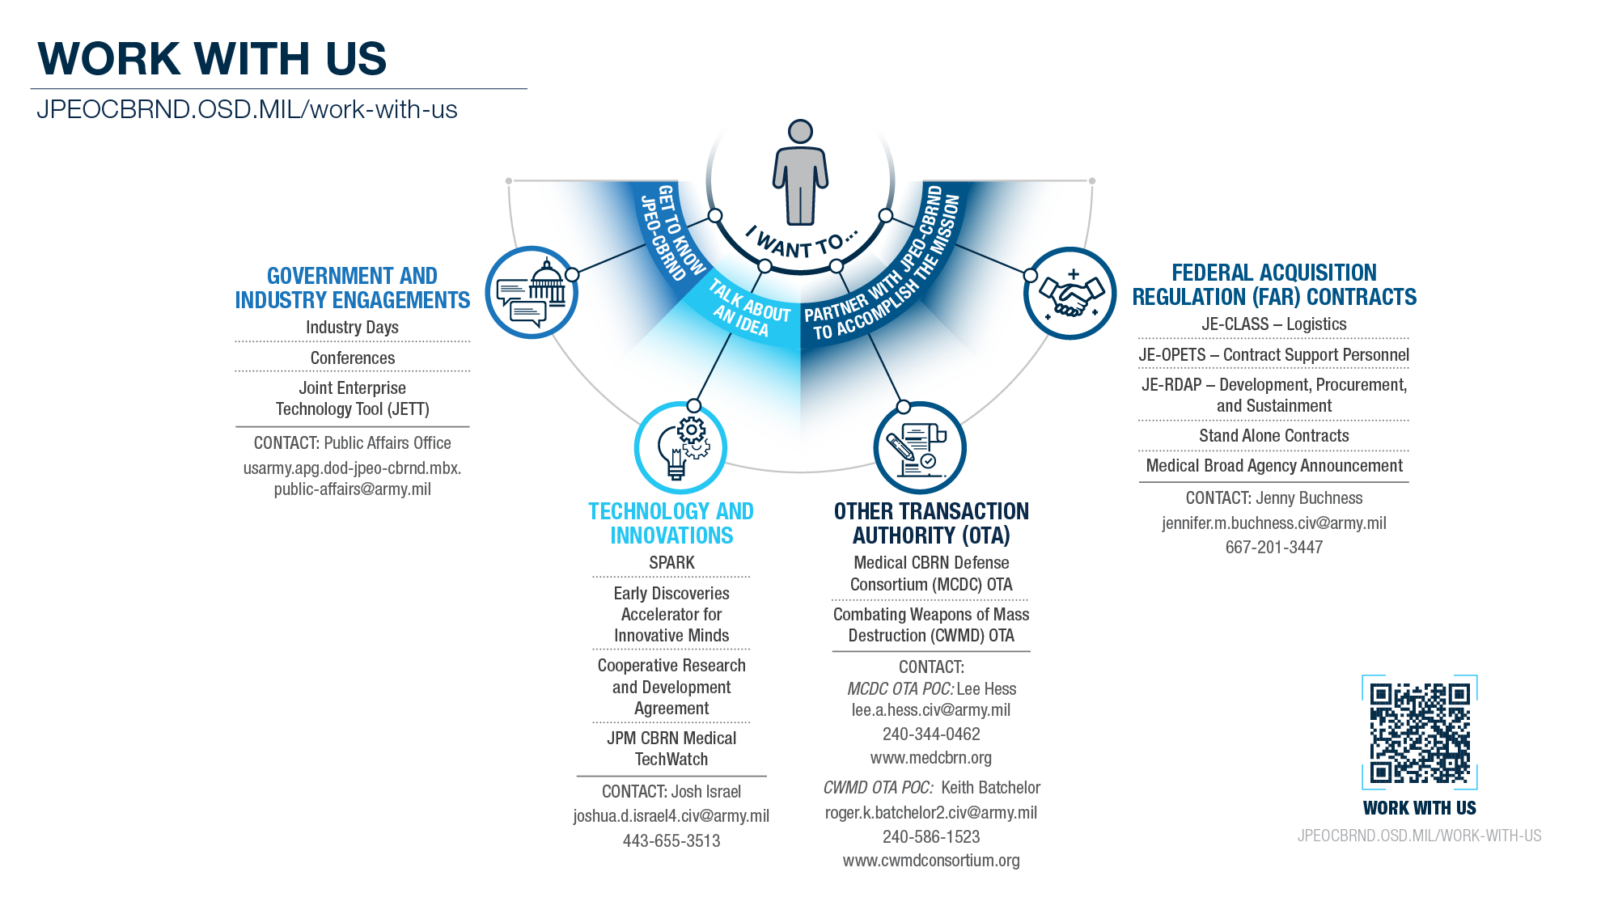
UNCLASSIFIED
Notes:
Work With Us
The JPEO-CBRND's mission to provide the best CBRN defense technology and equipment—the right place, at the right time, and for the right cost—is possible only with the participation from industry.
In support of the Joint Force, industry plays a vital role in supporting our Nation's defense.
There are a variety of channels and points of contact to engage with, share an idea, or partner with the JPEO, including through our new Joint Enterprise Technology Tool (JETT).

